Slide 1

DATABASE DESIGN & MANAGEMENT SI10317
PROGRAM STUDI SISTEM INFORMASI
UIVERRSITAS TARUMANAGARA

Slide 2
Exercises
Entity Relationship Modeling

Slide 3
Exercises 1
Create an ER model for each of the following descriptions:
A large organization has several parking lots, which are used by staff.
Each parking lot has a unique name, location, capacity, and number of floors (where appropriate).
Each parking lot has parking spaces, which are uniquely identified using a space number.
Members of staff can request the sole use of a single parking space. Each member of staff has a unique number, name, telephone extension number, and vehicle license number.
Represent all the ER models described in parts (a), (b), (c), and (d) as a single ER model. Provide any ssumptions necessary to support your model.

Slide 4
Exercises 2
Read the following case study, which describes the data requirements for a DVD rental company. The DVD rental company has several branches throughout the United States. The data held on each branch is the branch address made up of street, city, state, and zip code, and the telephone number. Each branch is given a branch number, which is unique throughout the company.
Each branch is allocated staff, which includes a Manager. The Manager is responsible for the day-to-day running of a given branch. The data held on a member of staff is his or her name, position, and salary. Each member of staff is given a staff number, which is unique throughout the company.

Slide 5
Exercises 2
Each branch has a stock of DVDs. The data held on a DVD is the catalog number, DVD number, title, category, daily rental, cost, status, and the names of the main actors and the director. The catalog number uniquely identifies each DVD. However, in most cases, there are several copies of each DVD at a branch, and the individual copies are identified using the DVD number. A DVD is given a category such as Action, Adult, Children, Drama, Horror, or Sci-Fi. The status indicates whether a specific copy of a DVD is available for rent.

Slide 6
Exercises 2
Before borrowing a DVD from the company, a customer must first register as a member of a local branch. The data held on a member is the first and last name, address, and the date that the member registered at a branch. Each member is given a member number, which is unique throughout all branches of the company. Once registered, a member is free to rent DVDs, up to a maximum of ten at any one time. The data held on each DVD rented is the rental number, the full name and number of the member, the DVD number, title, and daily rental, and the dates the DVD is rented out and returned. The DVD number is unique throughout the company.

Slide 7
Exercises 2
Identify the main entity types of the DVD rental company.
Identify the main relationship types between the entity types described in part (a) and represent each relationship as an ER diagram.
Determine the multiplicity constraints for each relationships described in part (b). Represent the multiplicity for each relationship in the ER diagrams created in part (b).
Identify attributes and associate them with entity or relationship types. Represent each attribute in the ER diagrams created in (c).
Determine candidate and primary key attributes for each (strong) entity type.
Using your answers to parts (a) to (e), attempt to represent the data requirements of the DVD rental company as a single ER diagram. State any assumptions necessary to support your design.

Slide 8
Jawaban Exercises 2
Identify the main entity types of the DVD rental company:
Branch {branchNO, street, city, state, zipcode, phone }
Staff {staffNO, name, position, salary}
DVD {catalogNO, dvdNO, title, category, rental, cost, actors, director}
DVDcopy {dvdNO, status}
DVDcateogory {categoryNO, categotyname}; ketentuan/asumsi ada nama kategori dan kode
Customer {memberNO, fname, lname, address}

Slide 9
Jawaban Exercises 2
Identify the main relationship types between the entity types described in part (a) and represent each relationship as an ER diagram:
Registration {dateregister}; ketentuan tanggal registrasi tercatat.
Rental {rentalNO, startdate, enddate}

Slide 10
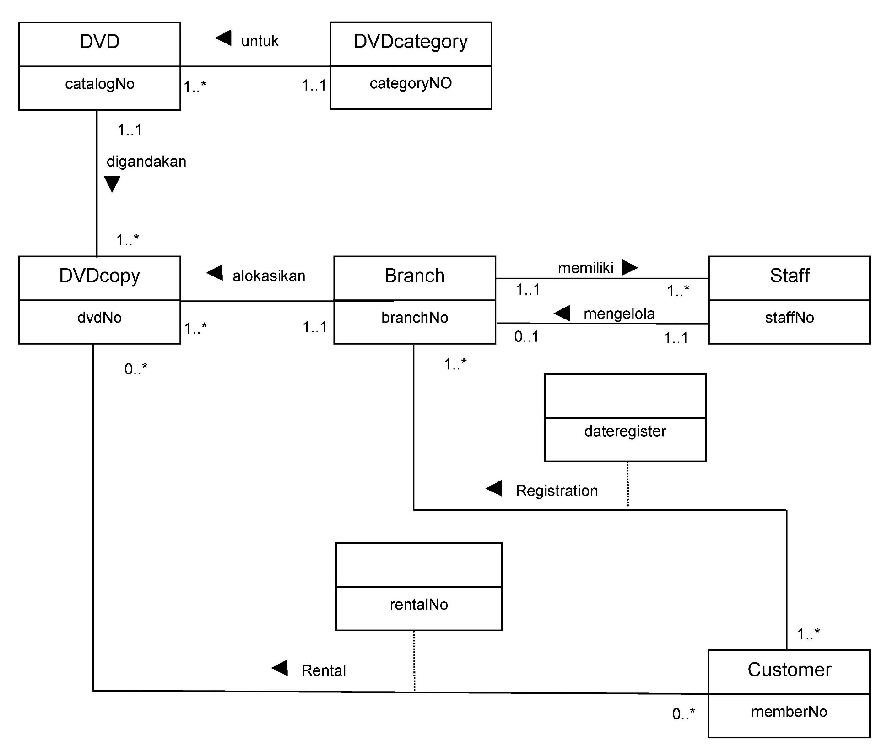
Jawaban Exercises 2: c, d, dan f

Slide 11
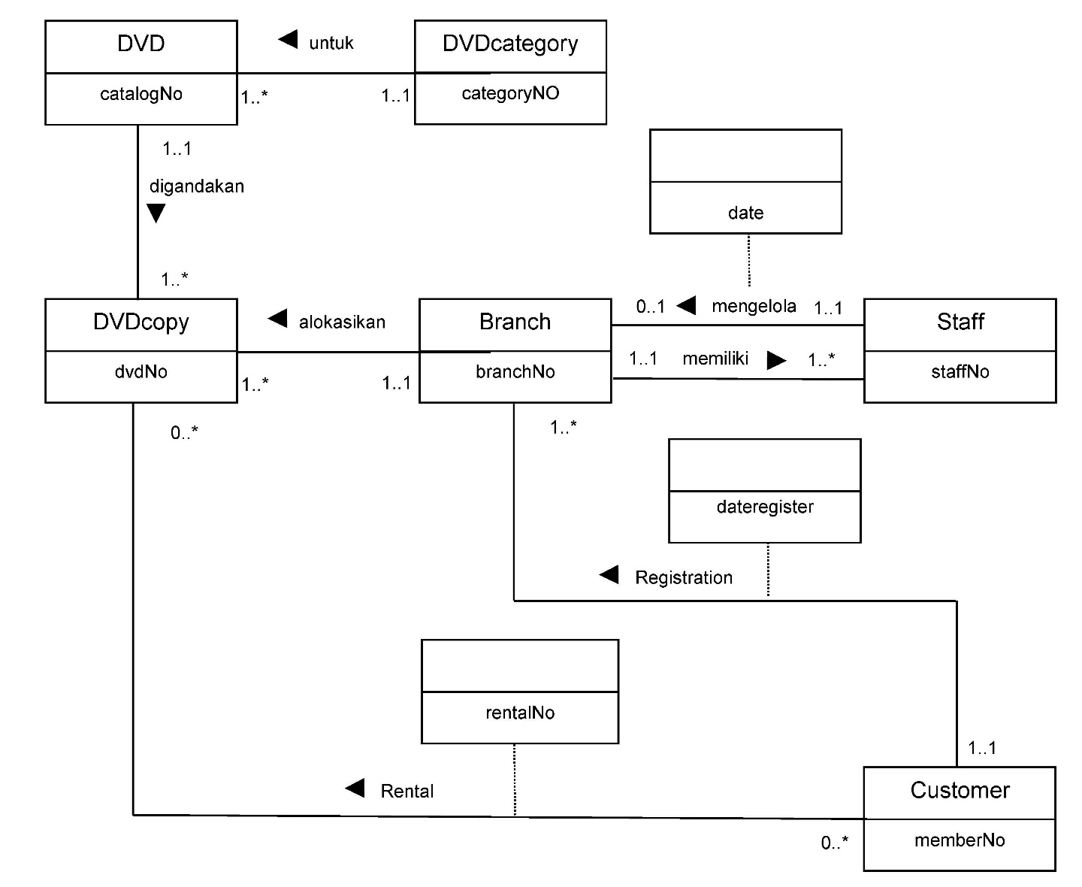
Jawaban Exercises 2: c, d, dan f
dengan asumsi adanya periode sbg manager

Slide 12
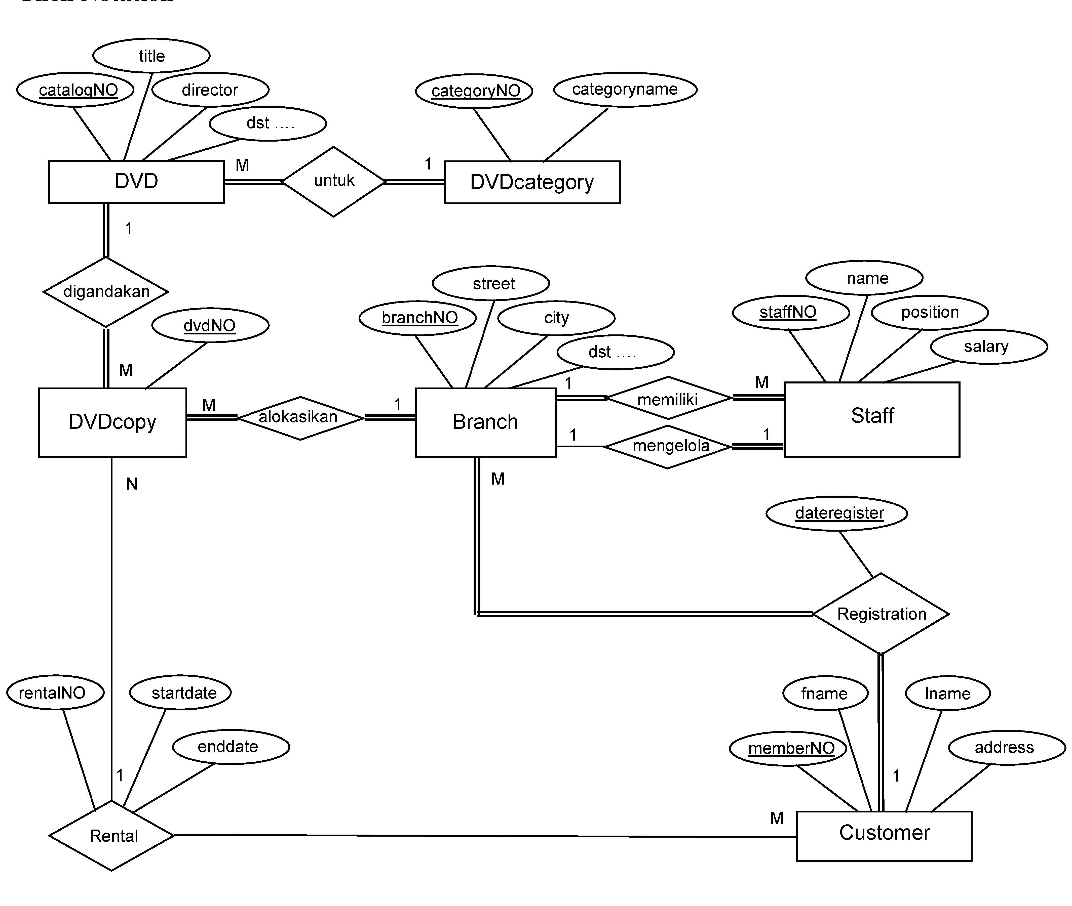
Jawaban Exercises 2: c, d, dan f
dengan notasi Chen

Slide 13
Jawaban Exercises 2
Determine candidate and primary key attributes for each (strong) entity type.
Branch: PK branchNO; FK staffNO untuk manager
Staff: PK staffNO; FK branchNO untuk staff branch
DVD: PK catalogNO; FK categoryNO
DVDcopy: PK dvdNO; FK catalogNO; karena DVDcopy merupakan penggandaan dari DVD maka jika 1 DVD digandakan menjadi 5 DVD akan memiliki data yg sama, sehingga pada entity DVDcopy hanya memiliki atribut untuk PK dan FK
DVDcateogory: PK categoryNO
Customer: PK memberNO

Slide 14
Jawaban Exercises 2
Determine candidate and primary key attributes for each (strong) entity type.
Registration: PK branchNO+memberNO; FK1 branchNO; FK2 memberNO
asumsi lain dapat berlaku untuk kejadian ini, misal tanggal regis tercatat, atau
customer dapat registrasi di branch lainnya.
Rental: PK dvdNO+memberNO+enddate;
atau PK dvdNO+memberNO+startdate
atau PK rentalNO;
FK1 dvdNO; FK2 memberNO
asumsi lain dapat berlaku untuk kejadian ini.
Attributes lengkap untuk setiap entity lihat berikut

Slide 15
Jawaban Exercises 2
Branch {branchNO, street, city, state, zipcode, phone, staffNO }
Staff {staffNO, name, position, salary, branchNO,}
DVD {catalogNO, dvdNO, title, category, rental, cost, status, actors, director, categoryNO,}
DVDcopy {dvdNO, catalogNO, status}
DVDcateogory {categoryNO, categotyname}; ketentuan/asumsi ada nama kategori dan kode
Customer {memberNO, fname, lname, address}
Registration {branchNO, memberNO, dateregister}; ketentuan tanggal registrasi tercatat.
Rental {rentalNO, memberNO, dvdNO, startdate, enddate}

Slide 16
Tugas: boleh mandiri atau kelompok maks 3 orang
Mengerjakan exercises 1 slide sebelumnya menggunakan ketiga notasi yang sudah dipelajari.
Mengerjakan exercises 2 dengan menggunakan notasi Crow’s Feet.

Slide 17
Thank You
Reference: Database Systems A Practical Approach to Design, Implementation, and Management Fourth Edition.
Thomas M. Connolly and Carolyn E. Begg

